Slide 1
BIRD STRIKE
Nazma Khatoon

Slide 2
Index No. | Title | Page No
1 | Introduction | 3
2 | Objective | 4
3 | Data Sharing Agreement | 5
5 | Insights | 6
6 | KPIs | 7
7 | My Design | 8

Slide 3
INTRODUCTION
Bird strikes, or the collision of birds with aircraft, present a multifaceted challenge to aviation safety and environmental conservation. As the aviation industry continues to expand globally, the frequency and severity of bird strikes have become significant concerns for airlines, airports, and wildlife management authorities alike. This report aims to provide a comprehensive overview of bird strikes, their causes, impacts, and potential mitigation strategies

Slide 4
OBJECTIVE
The objective of the project is to conduct a thorough analysis of bird strike incidents to enhance aviation safety. By examining historical data and patterns of bird strikes, the project aims to identify high-risk areas, species involved, and contributing factors. This analysis will provide valuable insights for the development of effective preventive measures and mitigation strategies, ultimately minimizing the impact of bird strikes on aircraft and improving overall aviation safety. The project seeks to offer a data-driven understanding of bird strike occurrences through visual representation and facilitate the implementation of targeted solutions to reduce the risks associated with bird strikes in aviation.
Using Microsoft Power bi

Slide 5
DATA SHARING AGGREMENT
File Name: Bird Str.csv
Dataset Size : 3.74MB
Number of Rows: 25559
Number of columns: 26

Slide 6
INSIGHTS
KPIS
Number of bird strikes incidents per year
Number of bird strikes incidents by Sky conditions
Cost Incurred due to bird strikes incidents

Slide 7
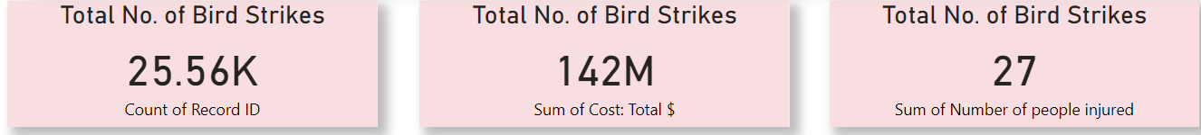
KPIS

Slide 8
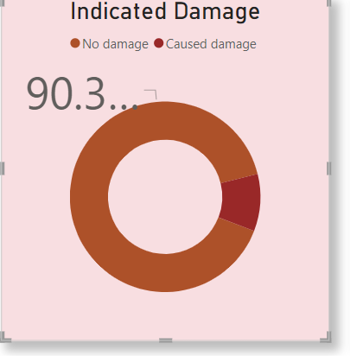
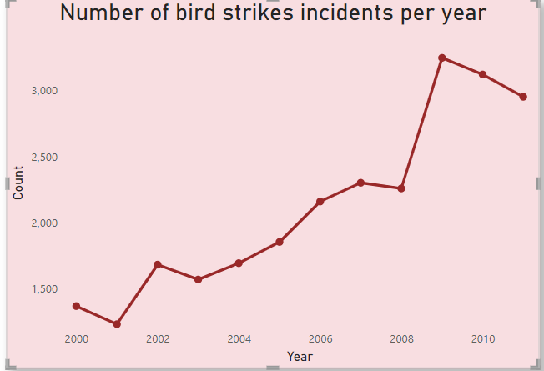
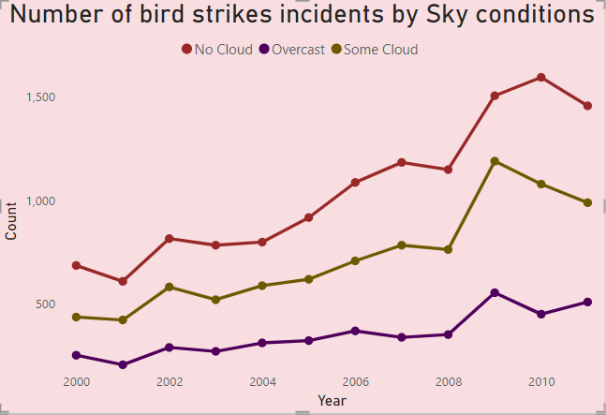
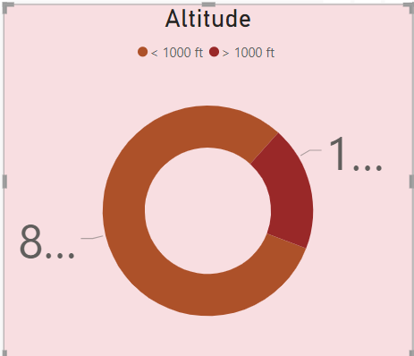
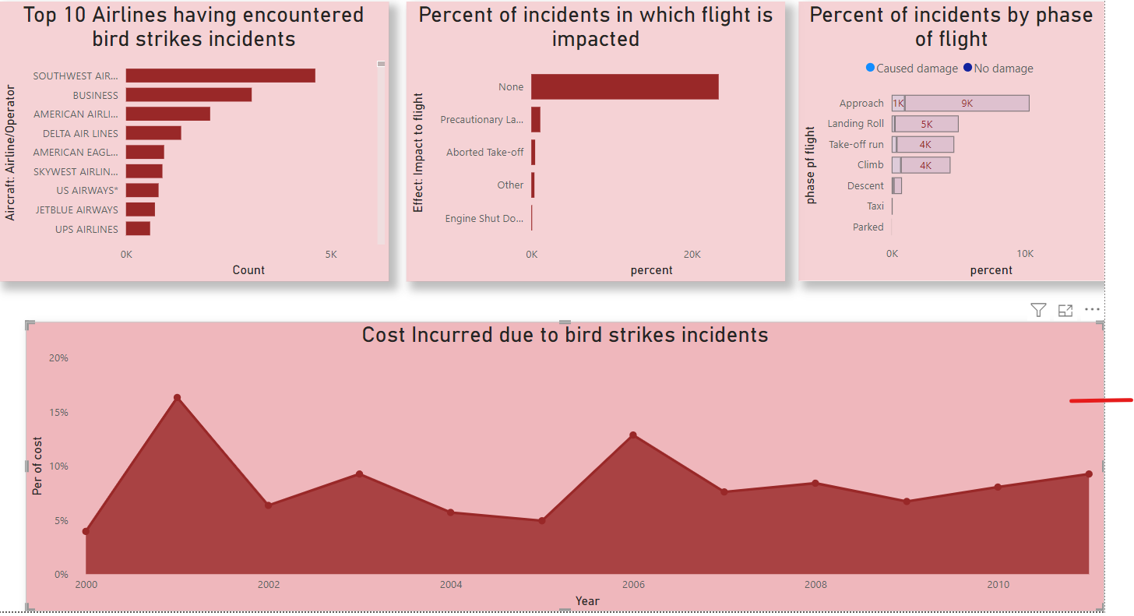
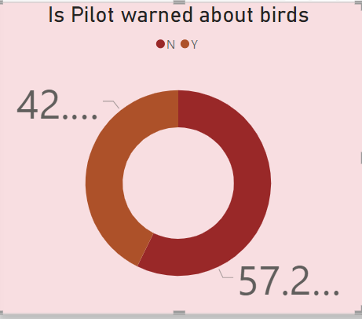
DESIGN

Slide 9
THANK YOU

